Slide 1
Computer performance issues*
Pipelines, Parallelism.
Process and Threads.
Notes:
* Illustrations from Tanenbaum, Structured Computer Organization, 5th Edition, Pearson. Chapter 6.
Bill Daly, Computers are your Future, Pearson Education, 9th Ed.

Slide 2
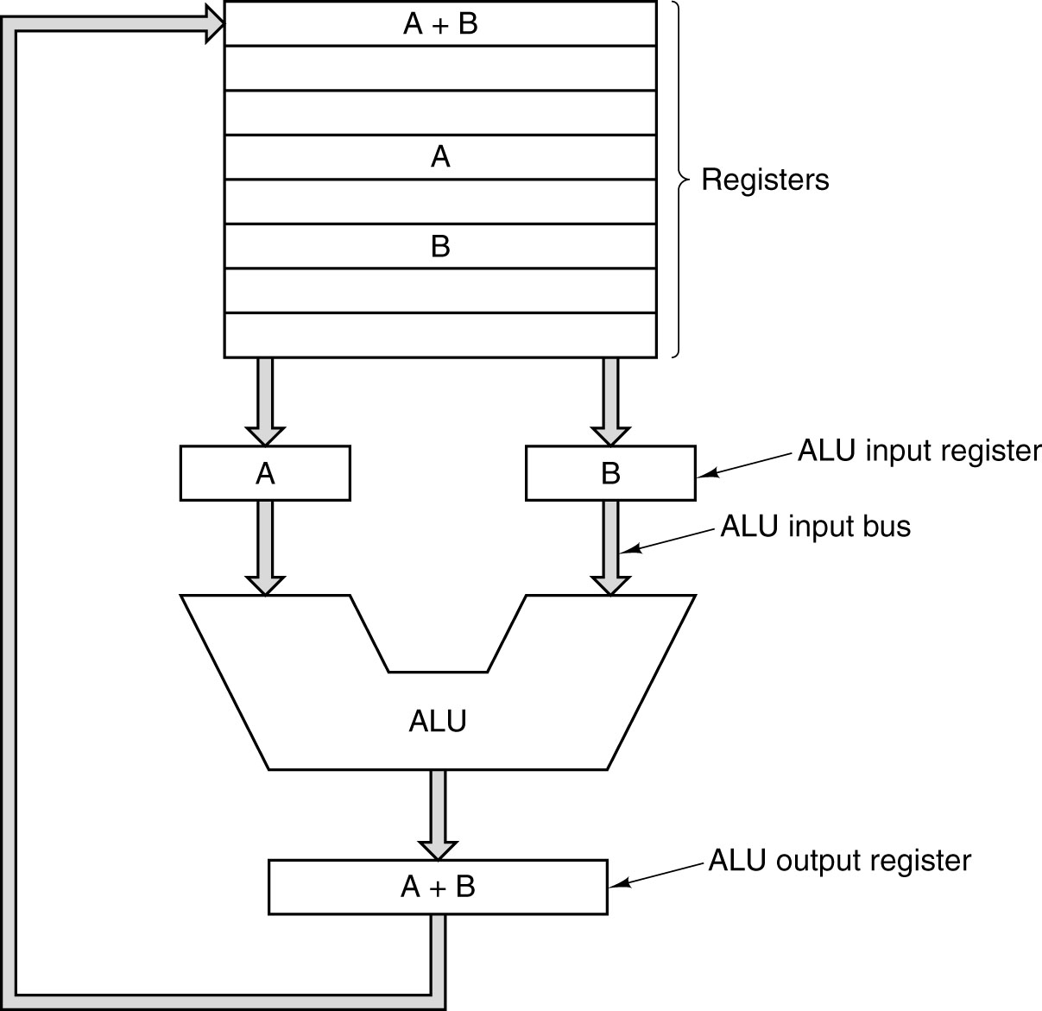
Review - The data path of a Von Neumann machine.

Slide 3
Review Fetch-Execute Cycle
Fetch next instruction from memory into instr. register
Change program counter to point to next instruction
Decode type of instruction just fetched
If instruction uses word in memory, determine where. Fetch word, if needed, into a CPU register
Execute the instruction
Go to step 1 to begin executing next instruction

Slide 4
General design principles for performance
Have plenty of registers
Execute instructions by hardware, not software
Make the instructions easy to decode: eg regular, fixed length, small number of fields
Access to memory takes a long time: Only Loads and Stores should reference memory
Maximise the rate at which instructions are issued (started): instructions are always encountered in program order, but might not be issued in program order; nor finish in program order

Slide 5
Pipelining
Instruction fetch is a major bottleneck in instruction execution; early designers created a prefetch buffer – instructions could be fetched from memory in advance of execution
Pipelining concept carries this idea further – divide the instruction execution into several stages, each handled by a special piece of hardware

Slide 6
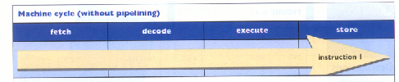
Instruction Fetch-execute cycle
In the above model, ‘fetch’ is performed in one clock cycle, ‘decode’ on 2nd clock cycle, ‘execute’ on 3rd clock cycle, ‘store’ result on 4th (No operand memory fetch)

Slide 7
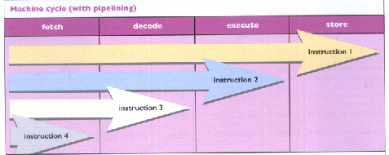
With Pipe-lining
Cycle 1: Fetch Instr 1
Cycle 2: Decode Instr 1;Fetch Instr 2
Cycle 3: Exec Instr 1;Decode Instr 2; Fetch Instr 3
Cycle 4: Store Instr 1;Exec Instr 2; decode Instr 3; Fetch Instr 4

Slide 8
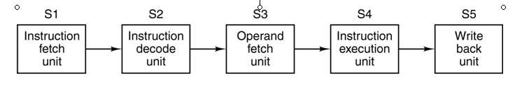
Instruction-Level Parallelism
A five-stage pipeline

Slide 9
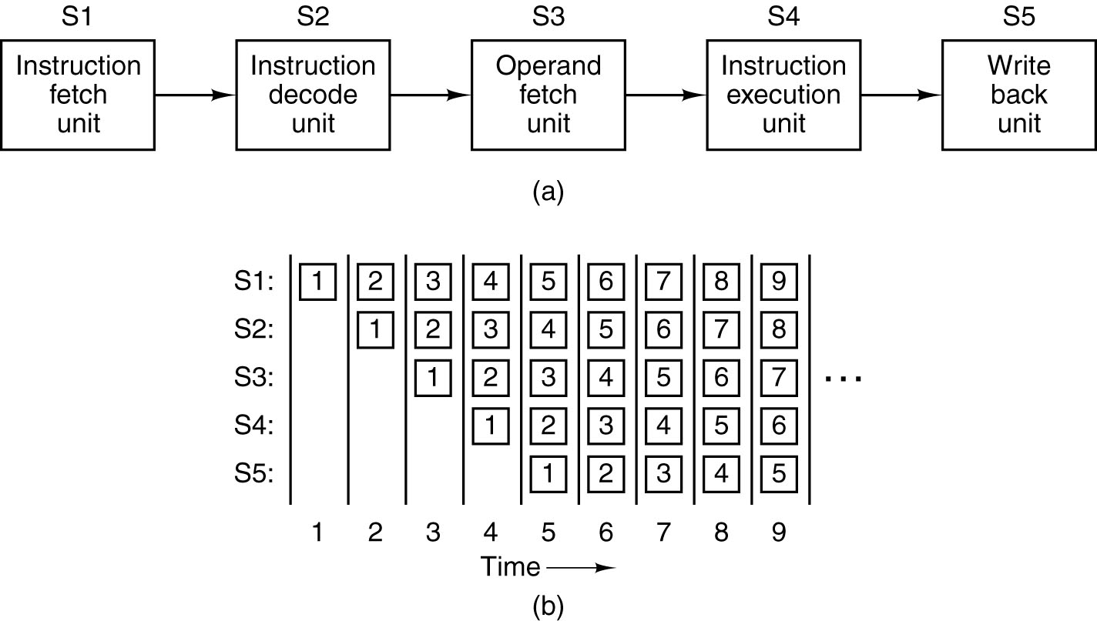
Instruction-Level Parallelism
The state of each stage as a function of time. Nine clock cycles are illustrated.
Intel 486 had one pipeline

Slide 10
Superscalar Architectures
A processor which issues multiple instructions in one clock cycle is called “Superscalar”

Slide 11
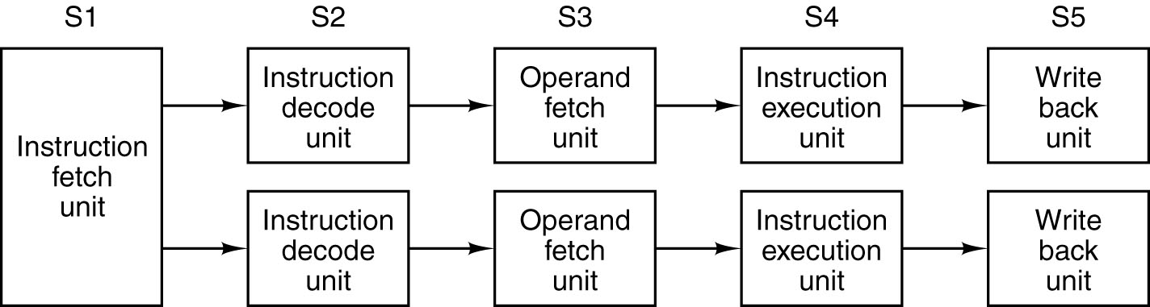
Superscalar Architectures (1)
Dual five-stage pipelines with a common instruction fetch unit.
Fetch Unit brings pairs of instructions to CPU;
Each instruction must not conflict over resources (registers), and instructions must not depend on each other.
Conflicts are detected and eliminated using extra hardware. If a conflict arises, only first instr is executed; 2nd is paired with next incoming instr
Basis for original Pentium; twice as fast as 486

Slide 12
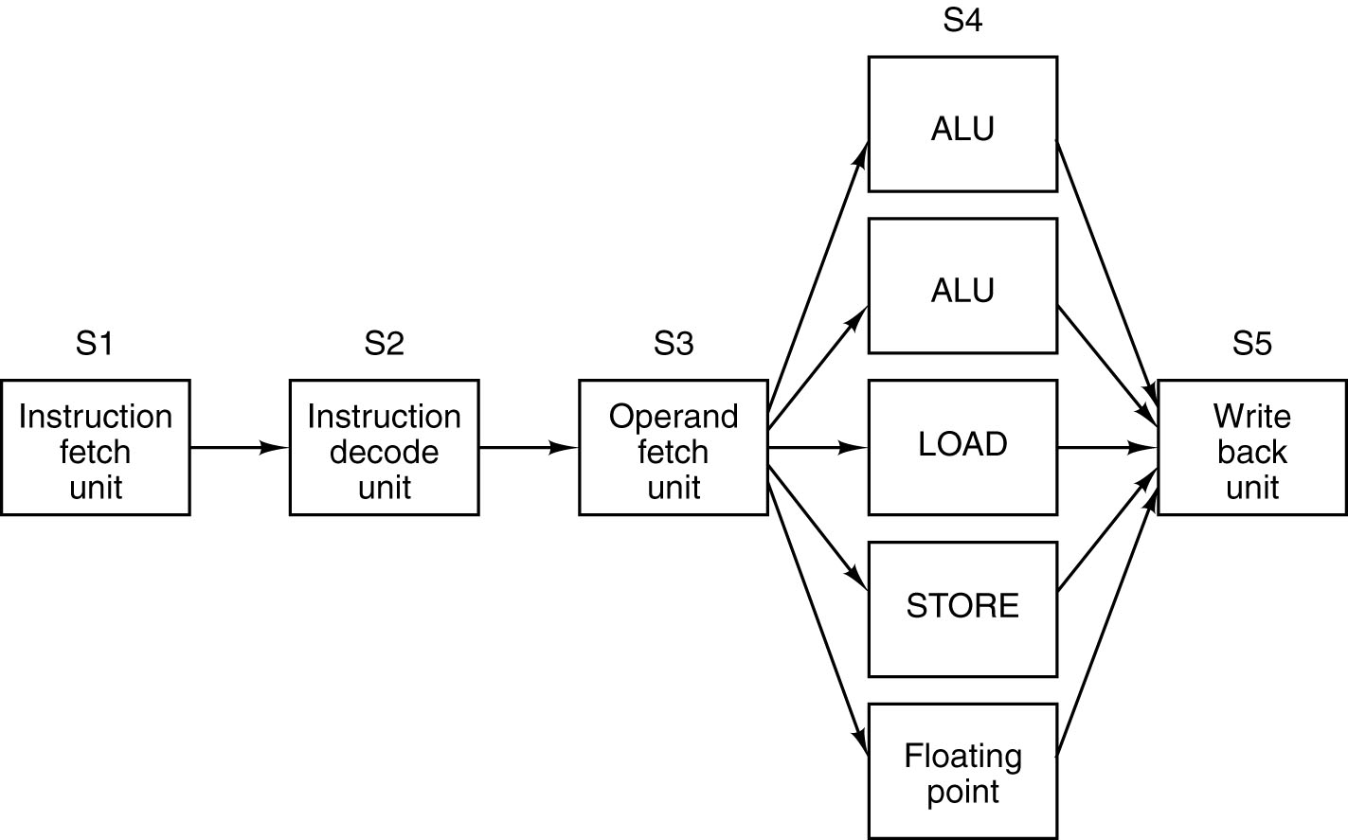
Superscalar Architectures (2)
A superscalar processor with five functional units.
High-end CPUs (Pentium II on) have one pipeline and several functional units
Most functional units in S4 take much longer than one clock cycle
Can have multiple CPUs in S4

Slide 13
Parallel Processing
Instruction-level Parallelism using pipelining and Superscalar techniques gets the speed up by a factor of 5 to 10
For gains of 50x and more, need multiple CPUs
An Array Processor is a large number of identical processors with one CPU that perform the same operations in parallel on different sets of data – suitable for processing large problems in engineering and physics. Idea is used in MMX (Multimedia eXtension) and SSE (Streaming SIMD Extensions) to speed up the graphics in later Pentiums
Array computer aka as SIMD – Single Instruction-stream, Multiple Data-stream
ILLIAC-IV 1972 had an array of Processors each with its own memory

Slide 14
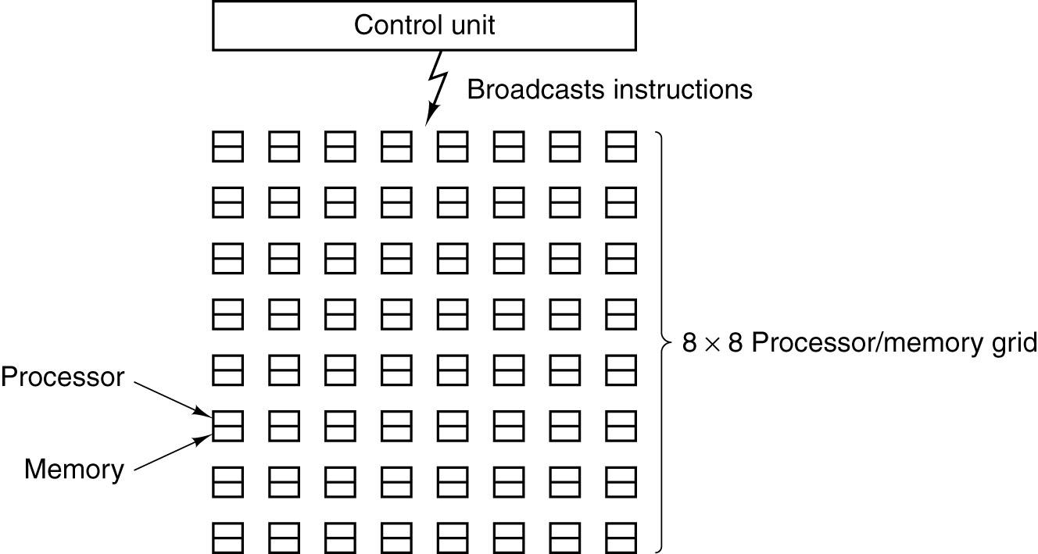
Processor-Level Parallelism (1)
An array of processors of the ILLIAC IV (1972) type.

Slide 15
Parallel processing - Multiprocessors
Many full-blown CPUs accessing a common memory can lead to conflict
Also, many processors trying to access memory over the same bus can cause problems

Slide 16
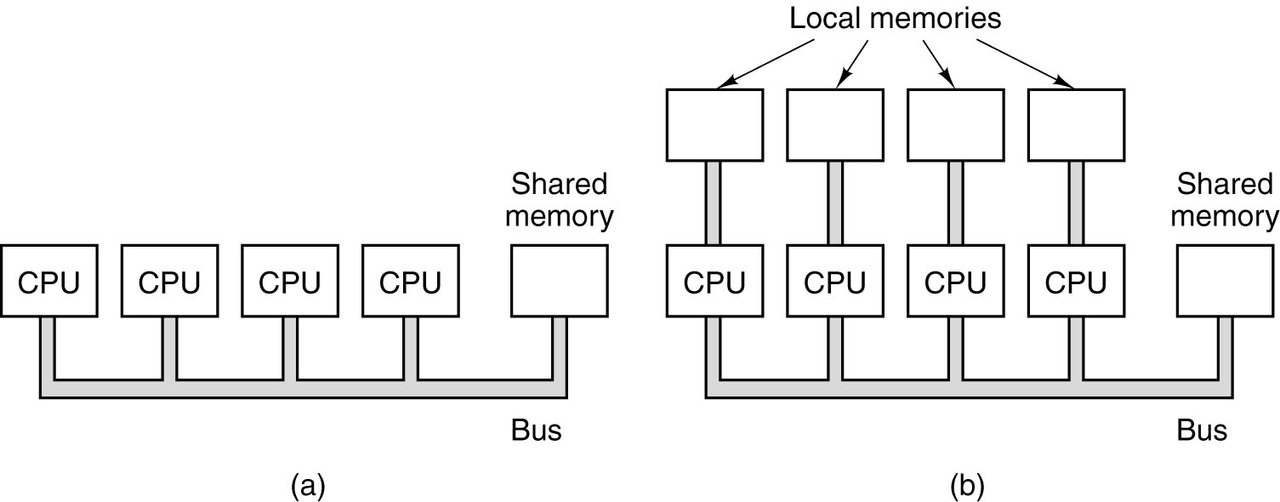
Processor-Level Parallelism (2)
a. A single-bus multiprocessor. (Good example application – searching areas of a photograph for cancer cells)
b. A multicomputer with local memories.

Slide 17
Parallelism now
Large numbers of PCs connected by high-speed network called COWs (Clusters of Workstations) or Server Farms can achieve a high degree of parallel processing
For example, a network server such as Google takes incoming requests and ‘sprays’ them among its servers to be processed in parallel

Slide 18
Process and Thread
A process is a running program, together with its State information such its own memory space, register values, program counter, stack pointer, PSW, I/O status
A process can be running, waiting to run, or blocked
When a process is suspended, its state data must be saved, while a new, other, process is invoked

Slide 19
Processes
are typically independent
carry state information
have separate address spaces
interact only through system-provided inter-process communication mechanisms

Slide 20
Thread
A thread is a mini-process; it uses the same address space
Run Excel – process
Run WP – process
  Handle Keyboard Input – high-priority thread
  Display text on screen – high-priority thread
  Spell-checker in WP – low-priority thread
The threads are invoked by the Process, and use its address space

Slide 21
Go faster?
The clock speed on current computers may be nearing its limit, due to heat problems – speed can be improved through Parallelism at different levels. Level 1 is On-Chip Level:
Pipelines. Can issue multiple instructions which can be executed in parallel by different functional units
Multithreading. CPU switches among multiple threads on an instr. by instr. basis, creating a virtual multiprocessor
Multiprocessing. Two or 4 cores on same chip

Slide 22
Level 2 Parallelism
Coprocessors
Extra processing power provided by plug-in boards :
Sound, Graphics
(Floating Point arithmetic)
Network Protocol Processing
I/O channels (I/O carried out independently of the CPU) – IBM 360 range

Slide 23
Level 3 Parallelism
Multiprocessors and Multicomputers
Multiprocessor is a parallel computer system with many CPUs, one memory space, and one Operating System
A Multicomputer system is a parallel system which consists of many computers, each with its own CPU, memory and OS; all connected by an interconnection network. Very cheap compared w multiprocessors, which are much easier to program. Different examples of multicomputers are IBM BlueGene/L, the Google cluster

Slide 24
Massively parallel Processors (MPP)
IBM BlueGene/L
Used for v large calculations, v large numbers of transactions per second, data warehousing (managing immense databases)
1000s of standard CPUs – PowerPC 440
Enormous I/O capability
High fault tolerance
71 teraflops /sec

Slide 25
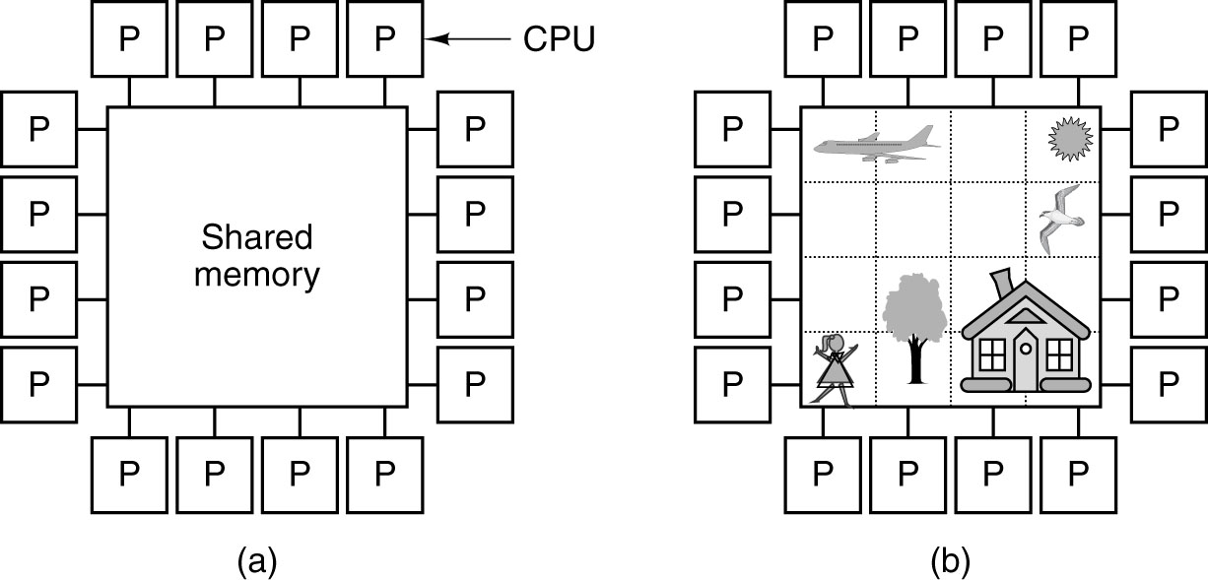
Multiprocessors
(a) A multiprocessor with 16 CPUs sharing a common memory.
(b) An image partitioned into 16 sections, each being analyzed by a different CPU.

Slide 26
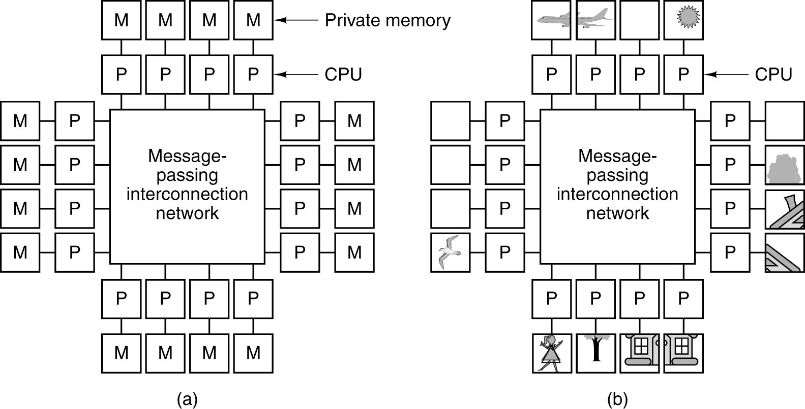
Multicomputers
(a) A multicomputer with 16 CPUs, each with its own private memory.
(b) The previous bit-map image, split up among the 16 memories.

Slide 27
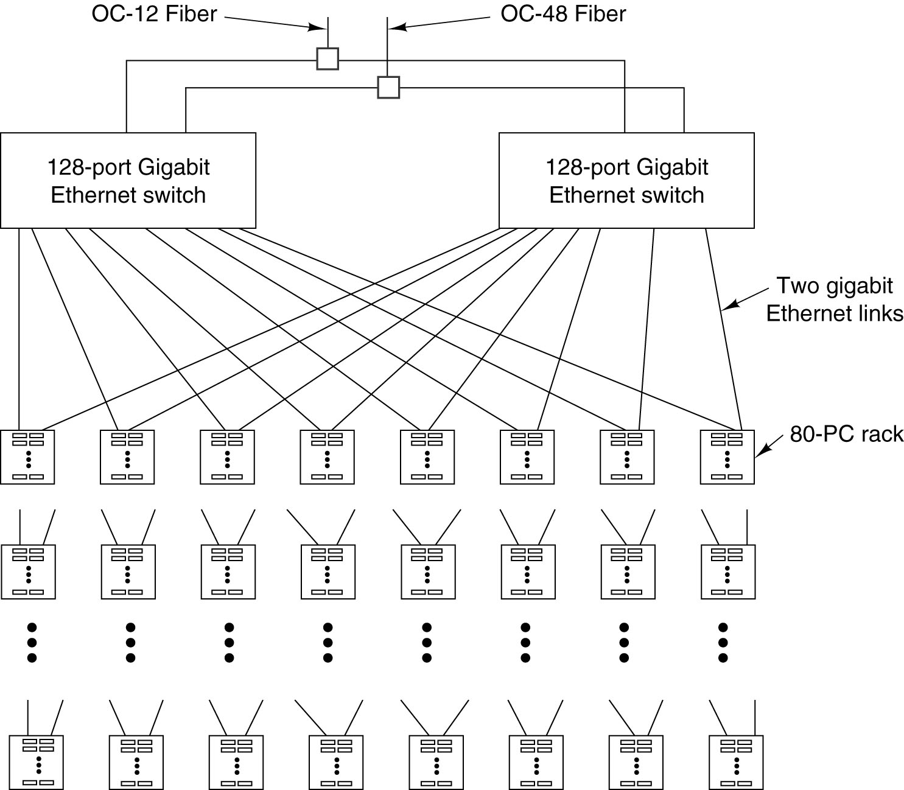
Google (2)
A typical Google
cluster. Up to 5120 PCs

Slide 28
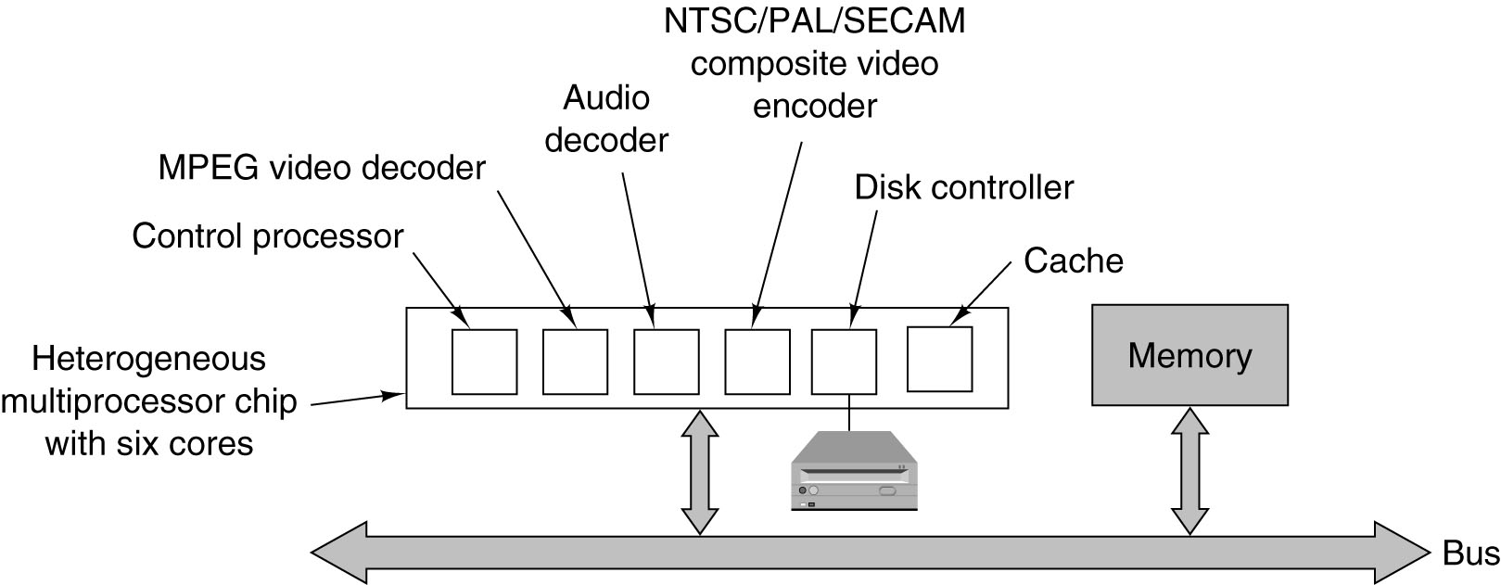
Heterogeneous Multiprocessors on a Chip – DVD player
The logical structure of a simple DVD player contains a heterogeneous multiprocessor containing multiple cores for different functions.

